Slide 1


Finding solutions to challenging and complex Cochrane reviews:
the National Institute for Health Research Complex Reviews Support Unit (NIHR CRSU)
Department of Health Disclaimer:
The views and opinions expressed herein are those of the authors and do not necessarily reflect those of NIHR, NHS or the Department of Health

Slide 2
Outline
NIHR CRSU
Supporting complex reviews
A Cochrane network meta-analysis: early mobilisation after stroke
An app for network meta-analysis - MetaInsight
Network meta-analysis of complex interventions - Component Analysis
Further complex reviews issues

Slide 3

website: www.nihrcrsu.org
twitter: @NIHRCRSU

Slide 4
Our Expertise
Network meta-analysis
Diagnostic test accuracy reviews
Individual participant data meta-analysis
Narrative synthesis
Realist synthesis
Economic evidence
Use of routine data
Non-randomised studies
Prognostic reviews
Prevalence reviews

Slide 5
Supporting Cochrane Reviews – Advice and Training
Reviewers
Review Groups
Incentive Awards
Programme Grants
Editorial Teams
Refining review questions
Consideration of types of data and data structure
Methodological approaches
Applications, protocols and reporting

Slide 6
Complex Reviews in Hepato-Biliary Disorders
Priority topics in the diagnosis and management of liver, gallbladder, and biliary tract disorders
Kurinchi Gurusamy and colleagues
Series of reviews of treatment for different indications
Complex interventions – life-style modification
Multiple treatment comparisons (network meta-analysis)

Slide 7

Complex Reviews in Oral Health
Detection and diagnosis of dental caries
Richard Macey and colleagues
Variation in thresholds
Imperfect reference standards
Multiple examiners
Multiple measurements per person

Slide 8

Complex Reviews in COPD
Priority topics:
Prognostic factors at EoL
Use of weather forecasting/pollution monitoring
Care pathways for multi-morbidity
Prophylactic antibiotics
Rebecca Normansell and colleagues
Complex questions
Utility of the review
Feasibility of quantitative synthesis
Multiple treatment comparisons (network meta-analysis)

Slide 9

Website: www.nihrcrsu.org
Twitter: @NIHRCRSU
E-mail: moira.sim@glasgow.ac.uk

Slide 10







Early mobilisation after stroke:
Meta-analysis approaches
Peter Langhorne,
Professor of stroke care,
Glasgow University

Slide 11
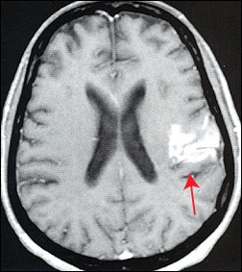
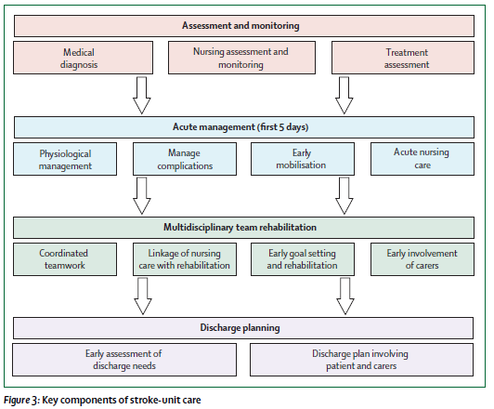
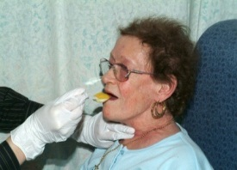
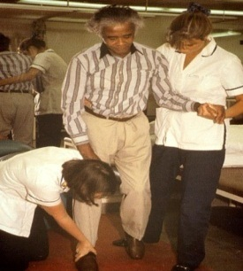
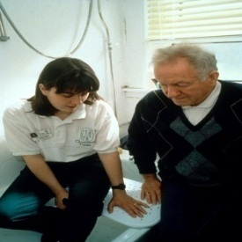
Limited evidence for individual components of stroke unit care
Langhorne et al Lancet Neurol (2012)

Slide 12
Limited evidence for individual components of stroke unit care
Langhorne et al Lancet Neurol (2012)

Slide 13
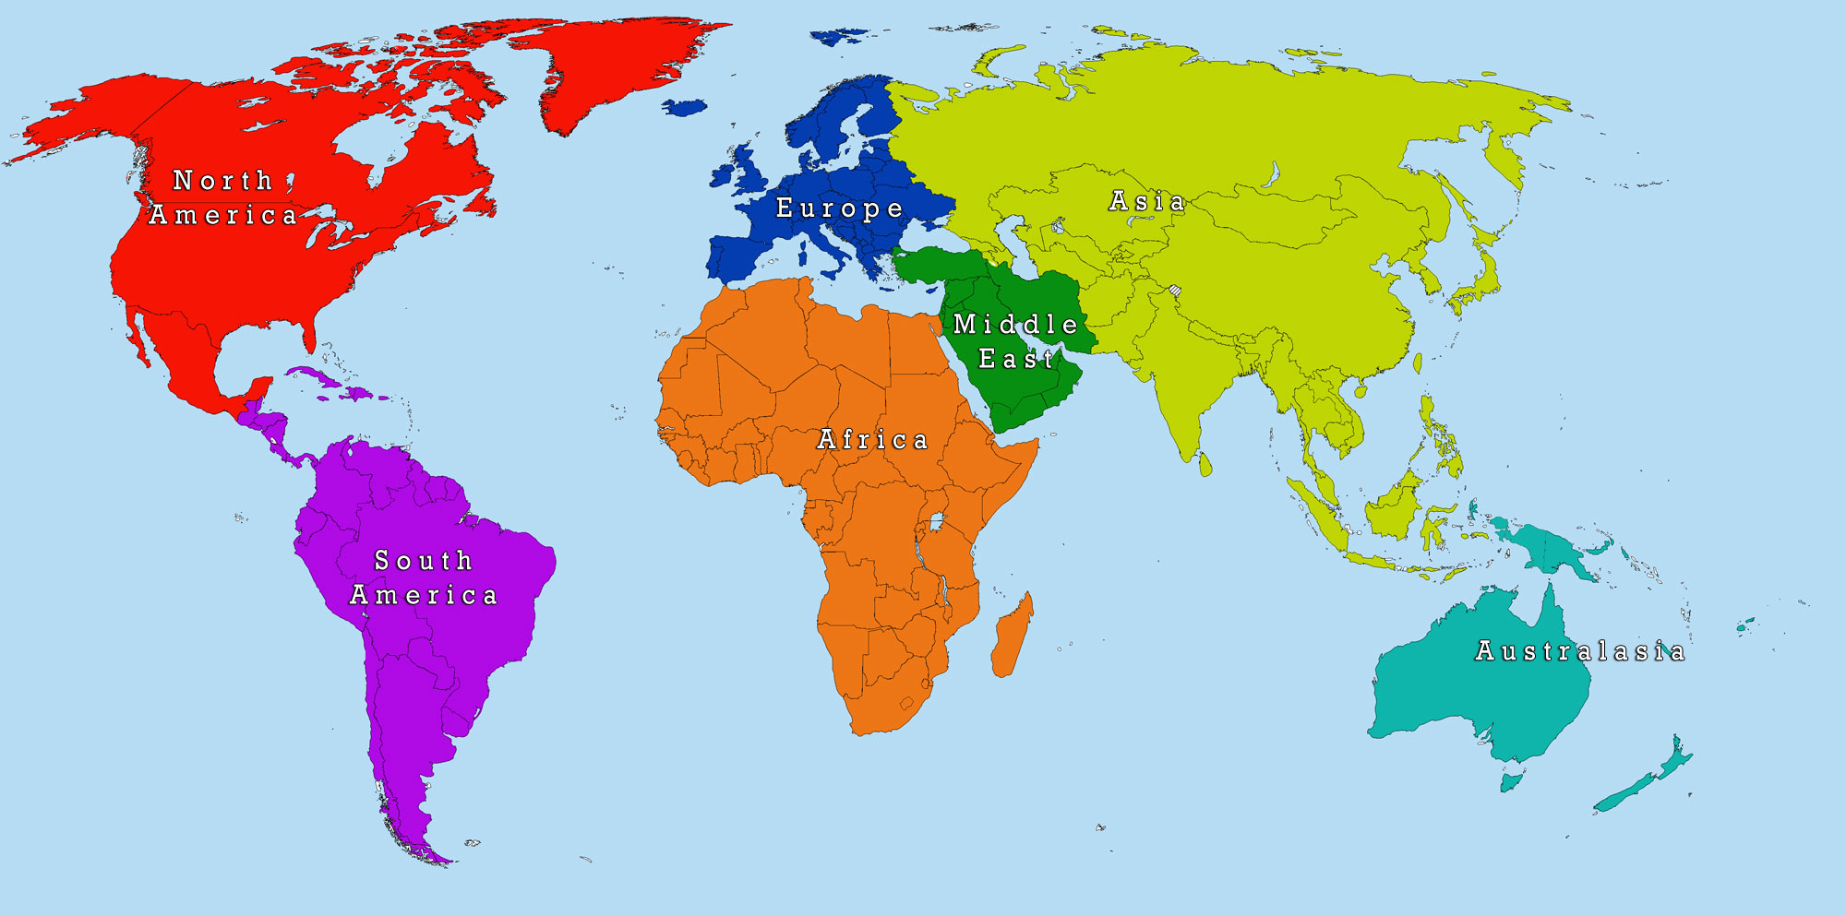

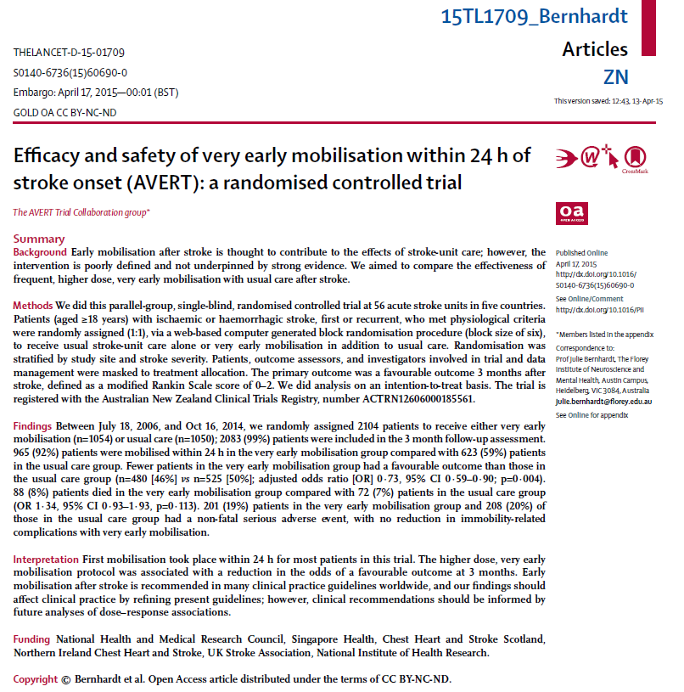

2104 participants recruited
56 centres (5 countries)
2006 - 2014
Complete follow up 2083 (99%)

Slide 14
+854 participants recruited
+20 centres (7 countries)
2008 - 2016
Complete follow up 2548/2618 (97%)
Akershus
Glasgow
SEVEL
Rome
Mangalore
Porto
Allegre
AVERT II

Slide 15
Primary outcome:
Dead or disabled (mRS 3-6) at 3 months
Secondary outcomes:
Death by 3 months
Exploratory analyses:
Time to first mobilisation (TTFM)
Akershus
Glasgow
SEVEL
Rome
Mangalore
Porto
Allegre
AVERT II

Slide 16
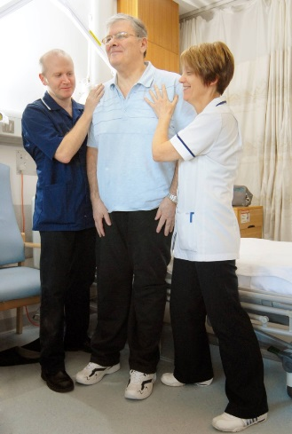

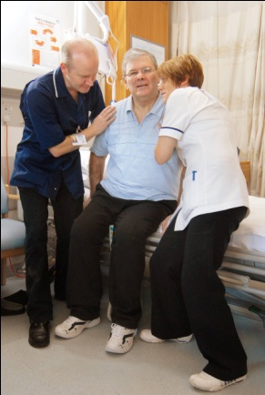
What is Very Early Mobilisation (VEM)?
Out of bed mobilisation within 48 hours of stroke
Aimed to reduce time to first mobilisation (TTFM)
  with or without an increase in the amount or frequency of mobilisation activities
Compared with usual care
  time to first mobilisation commenced later
Interventions provided by a physiotherapist + nurse team
Protocol/training provided to staff
Notes:
So what is VER?

Slide 17

Early Mobilisation trials
TTFM (time to first mobilisation)
Across all the trials in the Cochrane review:
Group | Median (range) TTFM
Very early mobilisation (VEM) | 18 (13 - 43) hours
Usual care (UC) | 33 (23 - 72) hours
Within trial difference (UC – VEM) | 13 (4 - 46) hours
Cochrane review (update in progress)

Slide 18
Trials of very early mobilisation
Trial | Aim |  |  | Early mobilisation TTFM (hours) | Usual Care TTFM (hours) | Frequency of mobilisation events per day | Average amount of mobilisation activity
AKEMIS 2012 | Earlier |  |  | 13.1 (8.5-25.6) | 33.3 (26.0-39.0) | Not stated | Not stated
AVERT II 2008 | Earlier & more |  |  | 18.1 (12.8-21.5) | 30.8 (23.0-39.9) | 2 vs 0 | 167 vs 69 mins mobilisation activity
AVERT III 2015 | Earlier & more |  |  | 18.5 (12.8-22.3) | 22.4 (16.5-29.3) | 6.5 vs 3 | 31 vs 10 mins per day of mobilisation activity
Glasgow 2010 | Earlier & more |  |  | 27.3 (26.0-29.0) | 32.0 (22.5-47.3) | Not stated | More EM patients (P=0.02) achieved standing or walking
Mangalore 2015a | Earlier & more |  |  | 18 (16.6-19.8) | 30.5 (29.0-35.0) | Not stated | Extra 5-30 mins per day of out of bed activity
Mangalore 2015b | Earlier & more |  |  | Same as 2015a | Same as 2015a | Same as 2015a | Same as 2015a
Porto Allegre 2015 | Earlier & more |  |  | 43 | 72 | 0.54 vs 0.03 | Extra 30 mins per day of out of bed activity
Rome 2016 | Earlier |  |  | <24 | 96 | Not stated | 60 mins per day for first 4 days
SEVEL 2016 | Earlier |  |  | 25.9 (22.5-29.3) | 71.5 (68.1-74.9) | Not stated | 83.7 vs 56.6 mins per day

Slide 19
Trials of very early mobilisation
Trial | Aim |  |  | Early mobilisation TTFM (hours) | Usual Care TTFM (hours) | Frequency of mobilisation events per day | Average amount of mobilisation activity
AKEMIS 2012 | Earlier |  |  | 13.1 (8.5-25.6) | 33.3 (26.0-39.0) | Not stated | Not stated
AVERT II 2008 | Earlier & more |  |  | 18.1 (12.8-21.5) | 30.8 (23.0-39.9) | 2 vs 0 | 167 vs 69 mins mobilisation activity
AVERT III 2015 | Earlier & more |  |  | 18.5 (12.8-22.3) | 22.4 (16.5-29.3) | 6.5 vs 3 | 31 vs 10 mins per day of mobilisation activity
Glasgow 2010 | Earlier & more |  |  | 27.3 (26.0-29.0) | 32.0 (22.5-47.3) | Not stated | More EM patients (P=0.02) achieved standing or walking
Mangalore 2015a | Earlier & more |  |  | 18 (16.6-19.8) | 30.5 (29.0-35.0) | Not stated | Extra 5-30 mins per day of out of bed activity
Mangalore 2015b | Earlier & more |  |  | Same as 2015a | Same as 2015a | Same as 2015a | Same as 2015a
Porto Allegre 2015 | Earlier & more |  |  | 43 | 72 | 0.54 vs 0.03 | Extra 30 mins per day of out of bed activity
Rome 2016 | Earlier |  |  | <24 | 96 | Not stated | 60 mins per day for first 4 days
SEVEL 2016 | Earlier |  |  | 25.9 (22.5-29.3) | 71.5 (68.1-74.9) | Not stated | 83.7 vs 56.6 mins per day

Slide 20
Early Mobilisation trials – Network meta-analysis
TTFM (time to first mobilisation) groups
VEM
(18 hours)
Usual care
(>30 hours)
Cochrane review (update in progress)

Slide 21
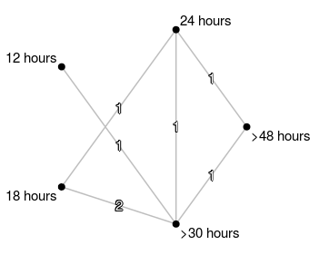
Early Mobilisation trials – Network meta-analysis
TTFM (time to first mobilisation) groups
VEM
(18 hours)
Usual care
(>30 hours)
Cochrane review (update in progress)

Slide 22
Early Mobilisation trials – Network meta-analysis
TTFM (time to first mobilisation) groups
VEM
(18 hours)
Usual care
(>30 hours)
Cochrane review (update in progress)

Slide 23
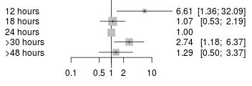
Early Mobilisation trials – Network meta-analysis
TTFM (time to first mobilisation) groups
TTFM group Odds ratio (95% CI) of a poor outcome
Poorer outcome (dead or disabled at 3 months)
Cochrane review (update in progress)

Slide 24
Early Mobilisation trials – Network meta-analysis
TTFM (time to first mobilisation) groups
TTFM group Odds ratio (95% CI) of a poor outcome
Poorer outcome (dead or disabled at 3 months)
Cochrane review (update in progress)

Slide 25

Early mobilisation after stroke
Very early (<24 hours) higher dose out of bed activity protocol reduced the odds of favourable outcome
Exploratory analysis suggests no TTFM was better than 24 hours
Guideline advice seems appropriate at present:
  “Patients with difficulty moving early after stroke who are medically stable should be offered frequent, short daily mobilisations typically beginning between 24 and 48 hours of stroke onset”
Work in progress!

Slide 26



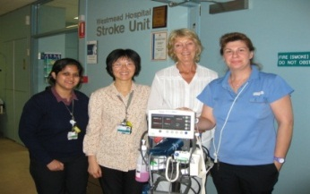





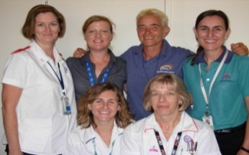













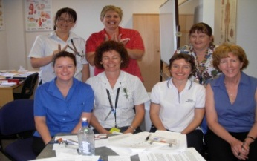



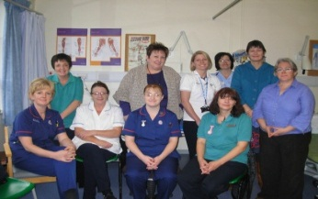



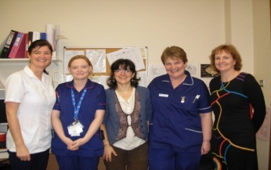






Thank you for
your attention

Slide 27
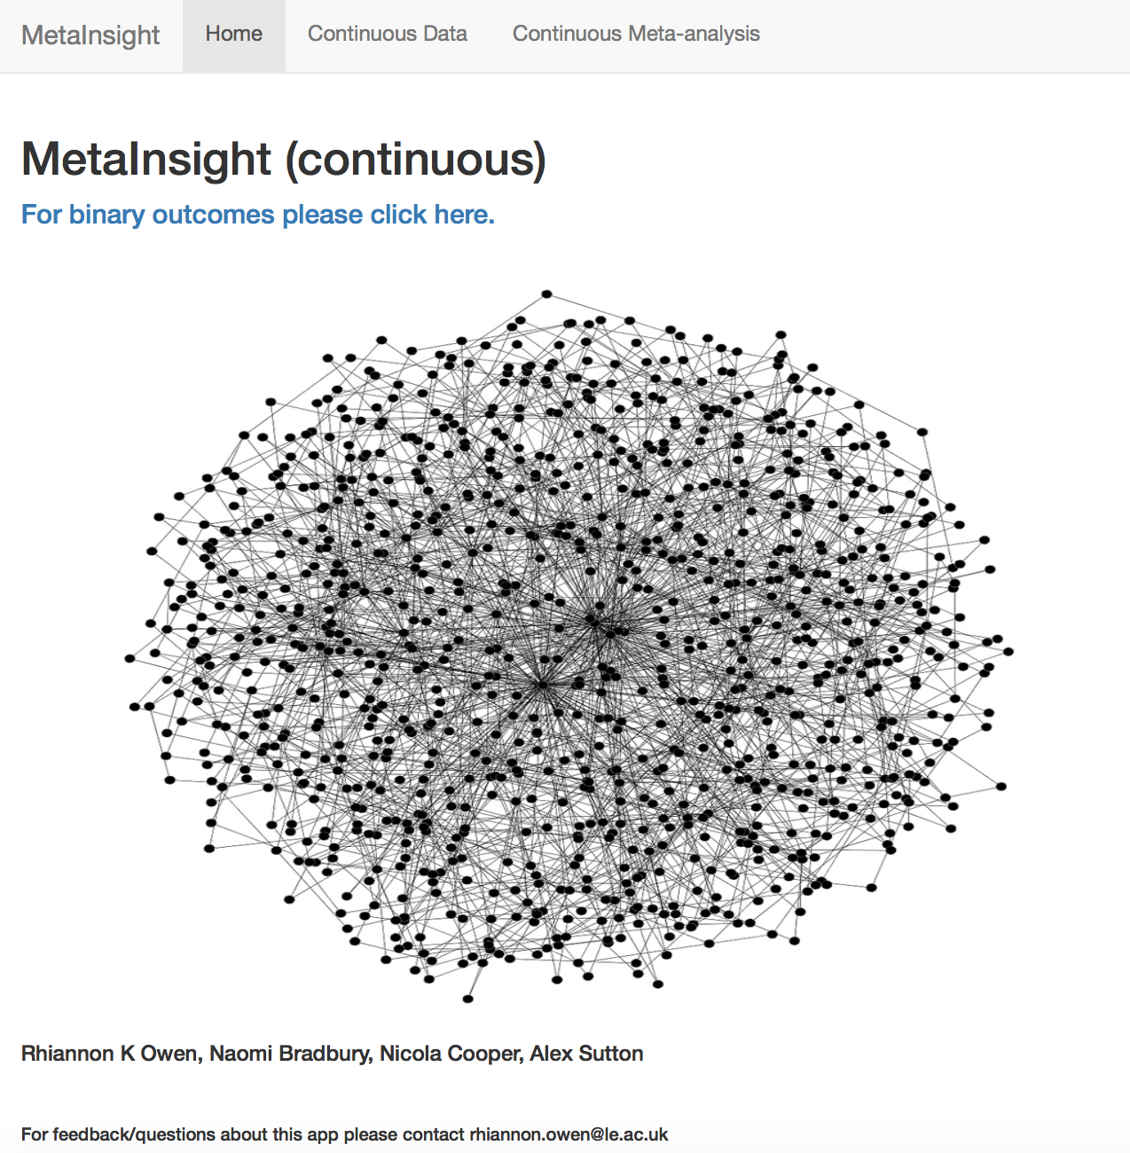

MetaInsight: an interactive web-based tool for analyzing, interrogating and visualizing network meta-analyses
Biostatistics Research Group, Department of Health Sciences
Rhiannon K Owen
@RhiannonKOwen
Acknowledgements: Naomi Bradbury,
Nicola Cooper, Alex Sutton

Slide 28

If you would like to follow the demo on your own device please scan the QR code or go to: https://crsu.shinyapps.io/metainsightc/
Biostatistics Research Group, Department of Health Sciences
MetaInsight demonstration

Slide 29

NIHR CRSU
Complex Reviews Support Unit
Component Network
Meta-Analysis
The Complex Reviews Support Unit (CRSU) is funded by the National Institute for Health Research (project number 14/178/29)
Department of Health Disclaimer:
The views and opinions expressed herein are those of the authors and do not necessarily reflect those of NIHR, NHS or the Department of Health

Slide 30

Background
May 2016 - Meta-analysis published in the Cochrane Database of Systematic Reviews identifying better postoperative outcomes (e.g. reduced length of stay in hospital, lower pain, reducing negative emotion) for patients who received any psychological preparation (strategies designed to influence thoughts, feelings or actions) compared to usual care

Slide 31
What is Psychological Preparation?
Can be considered as the intervention received by patients prior to surgery to help prepare them for surgery and minimise length of stay, pain and negative affect
Psychological preparation can consist of multiple components:
  Procedural information (What, when and how events will occur)
  Sensory information (What it will feel/smell like)
  Behavioural instruction (Teaching patients actions to perform to enhance the experience)
  Cognitive intervention (To change how an individual thinks)
  Relaxation (including hypnosis)
  Emotion-focused techniques (To help an individual manage their feelings)

Slide 32
What did they do in the Cochrane review?
Wanted to answer the question:
“What is the effect of psychological preparation on postoperative outcomes in adults undergoing elective surgery under general anaesthetic?”
Any Intervention
No Intervention
d

Slide 33
Assumptions in the Cochrane review?
All intervention arms were assumed to be equally effective irrespective of which treatment components were administered
Assumptions:
The effect of each component of intervention is the same
The effect of a single component is the same as a combination of components
P+B+E
P
P+S
S+B+E
P+S+R
P+C+R
P+B
B+C
S
S+B
P+S+C
Control
P+S+B+E
d
S+B+C+R
B
R
B+R
C
P+S+B

Slide 34
Additional Questions for NMA
Which individual components of psychological preparation before surgery are associated with better outcomes?
Are components more effective when delivered on their own or in combination?
Are component effects associated with control group risk? (i.e. Does length of stay in the control group affect length of stay in the intervention group?)
Are component effects associated with type of surgery?

Slide 35



Modelling Component Effects (1)
Let d represent the treatment effect, b the baseline treatment and k the intervention
Component effects can be accounted for by varying the assumption for
Pairwise Meta-Analysis (any intervention vs no intervention)
Network Meta-Analysis (each unique combination of interventions treated as a separate ‘treatment’)

Slide 36
Modelling Component Effects (2)
Component NMA models
Additive effects: separates out the component effects
where is an indicator variable taking the value 1 if P is a component of treatment k and 0 otherwise
Pairwise interactions between components: allows the effect of a combination to be greater/less than the sum of its individual components

Slide 37
Modelling Component Effects (3)
Study level covariates:
  Control group risk
  Type of surgery
Software
  All models fitted in WinBUGS
Comparison of models
  using the Deviance Information Criteria (DIC) but clinical expertise also sought to ensure appropriate model selected

Slide 38
Network Diagram for Length of Stay
P+S
R
C
P+B
B
S
S+B
P
B+C
No Intervention
B+R
S+B+C+R
P+S+B
P+S+B+E
P+S+C
S+B+E
P+S+R
P+B+E
P+C+R
P = procedural information, S = sensory information, B = behavioural instruction, C = cognitive intervention, R = relaxation techniques, E = emotion-focused intervention

Slide 39
Length of Stay
35 trials including four three-arm trials and two four-arm trials
18 interventions
Continuous outcome – number of days in hospital
All trials had a ‘no intervention’ control arm
Cochrane review identified any intervention reduces length of stay by 0.52 days (95% CrI: -0.82, -0.22)

Slide 40
Length of Stay Forest Plot
Author
Intervention
MD (95% CI)
MD (95% CI)
Cunado Barrio 1999
P
-6.00 (-9.95, -2.05)
Beaupre 2004
B
-6.00 (-9.95, -2.05)
-0.60 (-1.46, 0.26)
Bergin 2014
B
-0.60 (-1.46, 0.26)
-0.20 (-0.43, 0.03)
Bitterli 2011
B
-0.20 (-0.43, 0.03)
0.00 (-1.19, 1.19)
Chaudhri 2005
B
0.00 (-1.19, 1.19)
-1.82 (-3.38, -0.26)
D'Lima 1996
B
-1.82 (-3.38, -0.26)
0.12 (-0.65, 0.88)
Hulzebos 2006a
B
0.12 (-0.65, 0.88)
-1.99 (-5.41, 1.43)
Oosting 2012
B
-1.99 (-5.41, 1.43)
-0.30 (-1.48, 0.88)
Ashton 1997
R
-0.30 (-1.48, 0.88)
1.80 (-0.86, 4.46)
Leserman 1989
R
1.80 (-0.86, 4.46)
-0.80 (-3.04, 1.44)
Levin 1987
R
-0.80 (-3.04, 1.44)
-0.81 (-2.69, 1.07)
Daltroy 1998
P+S
-0.81 (-2.69, 1.07)
-0.08 (-1.18, 1.03)
Doering 2000
P+S
-0.08 (-1.18, 1.03)
0.30 (-0.87, 1.47)
Crowe 2003
P+B
0.30 (-0.87, 1.47)
-3.95 (-7.57, -0.33)
Fortin 1976
P+B
-3.95 (-7.57, -0.33)
-0.09 (-1.02, 0.84)
McGregor 2004
P+B
-0.09 (-1.02, 0.84)
-3.00 (-4.99, -1.01)
Shuldham 2002
P+B
-3.00 (-4.99, -1.01)
0.92 (-0.12, 1.96)
Zieren 2007
P+B
0.92 (-0.12, 1.96)
0.00 (-0.78, 0.78)
Lam 2001
S+B
0.00 (-0.78, 0.78)
-1.00 (-1.80, -0.20)
Watt-Watson 2000
B+C
-1.00 (-1.80, -0.20)
0.46 (-0.22, 1.13)
Watt-Watson 2004
B+C
0.46 (-0.22, 1.13)
0.20 (-0.72, 1.12)
Rajendran 1998
B+R
0.20 (-0.72, 1.12)
-6.20 (-9.42, -2.98)
Lindeman 1973
P+S+B
-6.20 (-9.42, -2.98)
0.05 (-0.83, 0.93)
Zhang 2012
P+S+B
0.05 (-0.83, 0.93)
-2.10 (-2.92, -1.28)
Mahler 1995
P+S+C
-2.10 (-2.92, -1.28)
-1.00 (-2.16, 0.15)
Schmitt 1973
P+B+E
-1.00 (-2.16, 0.15)
0.00 (-1.65, 1.65)
Furze 2009
P+C+R
0.00 (-1.65, 1.65)
-0.67 (-1.76, 0.42)
Lin 2005
S+B+E
-0.67 (-1.76, 0.42)
-0.01 (-3.22, 3.20)
Giraudet 2003
P+S+B+E
-0.01 (-3.22, 3.20)
0.20 (-0.76, 1.16)
Mahler 1998
P+S+B/P+S+C
0.20 (-0.76, 1.16)
-0.96 (-1.11, -0.80)
Ridgeway 1982
C/P+S
-0.96 (-1.11, -0.80)
1.50 (-0.09, 3.10)
Ziemer 1982
S/S+B+C+R
1.50 (-0.09, 3.10)
-0.96 (-2.34, 0.42)
Felton 1976
C/P+S+B
-0.96 (-2.34, 0.42)
-2.03 (-3.59, -0.46)
Wilson 1981
R/P+S/P+S+R
-2.03 (-3.59, -0.46)
-0.98 (-1.74, -0.23)
Langer 1975
C/P+S/P+S+C
-0.98 (-1.74, -0.23)
-1.24 (-2.98, 0.50)
NOTE: Weights are from random effects analysis
-1.24 (-2.98, 0.50)
-9.95
0
0
9.95

Slide 41
Length of Stay – Additive Effects
Intervention | Mean (95% Credible Interval)
Control group risk (centered on mean of 9 days) | -0.098 (-0.157, -0.043)
Procedural information (P) | -0.308 (-1.022, 0.360)
Sensory information (S) | -0.313 (-1.004, 0.439)
Behavioural instruction (B) | -0.561 (-1.047, -0.111)
Cognitive intervention (C) | -0.444 (-1.106, 0.214)
Relaxation techniques (R) | -0.368 (-1.154, 0.412)
Emotion-focused techniques (E) | 1.296 (-0.028, 2.700)
For every one day increase in control group length of stay, the length of stay in the intervention arm is reduced by 0.1 days

Slide 42
Effect of type of surgery on length of stay
Most effective component dependent on type of surgery

Slide 43
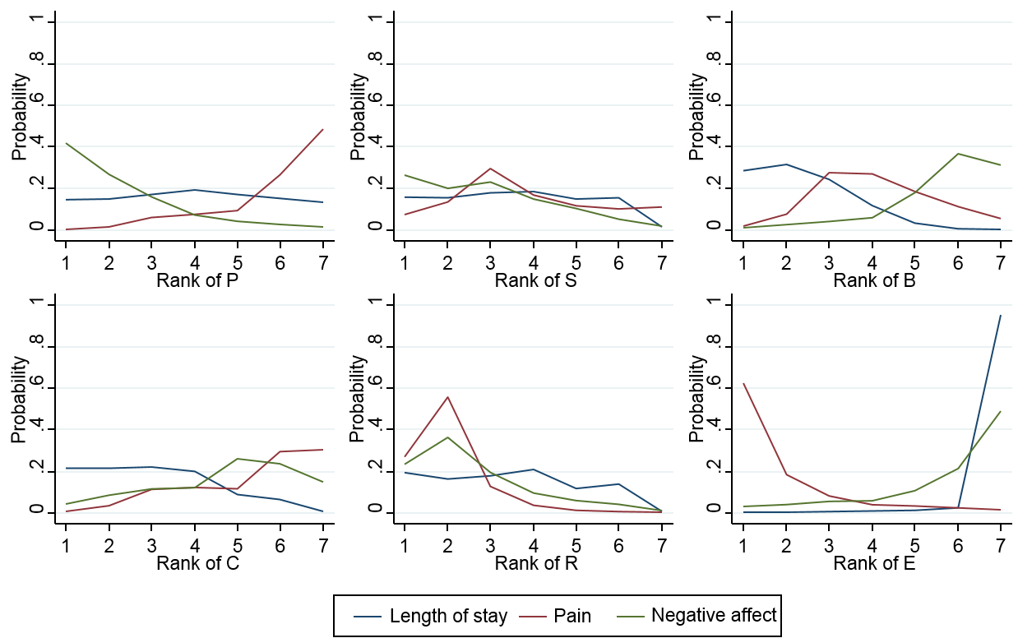
Simultaneous assessment across outcomes

Slide 44
Summary
For all three outcomes the additive effects model was most appropriate
  No important pairwise interactions between components were identified for any outcome
Reduction in length of stay and negative emotion were associated with control group risk
Procedural information, sensory information and behavioural instruction may reduce length of stay but this depends on type of surgery
Relaxation effective at reducing pain
No single component identified as most effective across all three outcomes

Slide 45
Limitations
We only assessed pairwise interactions and the model may have been underpowered to identify pairwise interactions as there were few studies evaluating each component
  There may be interactions between three or more components but too few studies to evaluate
We assumed consistency between the direct and the indirect evidence but were unable to test this assumption
Between-study heterogeneity only partly explained by inclusion of control group risk as a covariate
  Is an additive scale inappropriate?
  Could a ratio scale be better?

Slide 46
Conclusions
Component network meta-analysis added value to an existing meta-analysis
  Allowed us to answer more clinically relevant questions regarding effectiveness of individual components
Component network meta-analysis could be more widely used in systematic reviews involving complex interventions
This approach could be utilised when considering cost-effectiveness - more intensive interventions may be justified on cost-effectiveness grounds for certain types of surgery

Slide 47
Ongoing Projects in Component NMA
Cochrane Tobacco Addiction
  Behavioural interventions for smoking cessation
Cochrane Dementia & Cognitive Improvement
  Non-pharmacological interventions for preventing delirium in hospitalised non-ICU patients

Slide 48
References
Freeman SC, Scott NW, Powell R, Johnston M, Sutton AJ, Cooper NJ. Component network meta-analysis identifies the most effective components of psychological preparation for adults undergoing surgery under general anesthesia. Journal of Clinical Epidemiology 2018 https://doi.org/10.1016/j.jclinepi.2018.02.012
Powell R, Scott NW, Manyande A, et al. Cochrane Database of Systematic Reviews 26 MAY 2016 DOI: 10.1002/14651858.CD008646.pub2
http://onlinelibrary.wiley.com/doi/10.1002/14651858.CD008646.pub2/full#CD008646
Welton NJ, Caldwell DM, Adamopoulos E, Vedhara K. Mixed treatment comparison meta-analysis of complex interventions: psychological interventions in coronary heart disease. Am J Epidemiol 2009:169 (9);1158-1165

Slide 49
NIHR CRSU
Complex Reviews Support Unit
Further Topics
The Complex Reviews Support Unit (CRSU) is funded by the National Institute for Health Research (project number 14/178/29)
Department of Health Disclaimer:
The views and opinions expressed herein are those of the authors and do not necessarily reflect those of NIHR, NHS or the Department of Health

Slide 50
OUTLINE
✓Network meta-analysis
Diagnostic Test Accuracy Reviews
  DTA-MA App https://crsu.shinyapps.io/dta_ma/
Individual patient data
Prognostic Reviews
Sequential analysis
Using evidence synthesis to help inform the next study
Non-statistical synthesis of qualitative data
How can the CRSU help your group

Slide 51
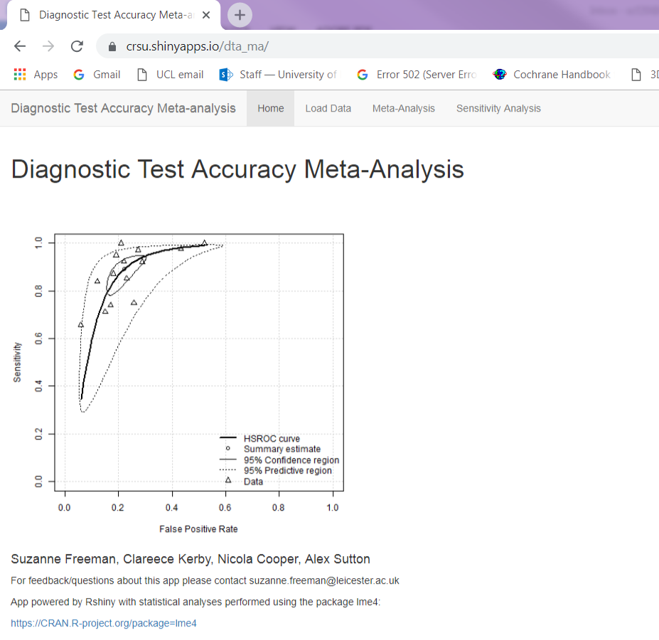
Diagnostic Test Accuracy Meta-analysis
Tuesday 18th September 11:00 – 11:10 Carrick 3, OS43
‘An interactive web application to aid diagnostic test accuracy meta-analysis’
https://crsu.shinyapps.io/dta_ma/

Slide 52
Individual Patient Data (IPD)
Desirable
Can greatly improve power and reliability of patient level covariate (e.g. subgroup) analyses
IPD models for pairwise meta-analysis and NMA possible
IPD diagnostic test models evolving
Often not possible to obtain IPD from all relevant studies
  Methods to use IPD where available and summary data otherwise exist

Slide 53
Prognostic Reviews
First Cochrane pilots / exemplar reviews underway
Under developed area
Seek guidance from Cochrane Prognostic Review Methods Group in the first instance
CRSU has some, but not extensive, experience

Slide 54
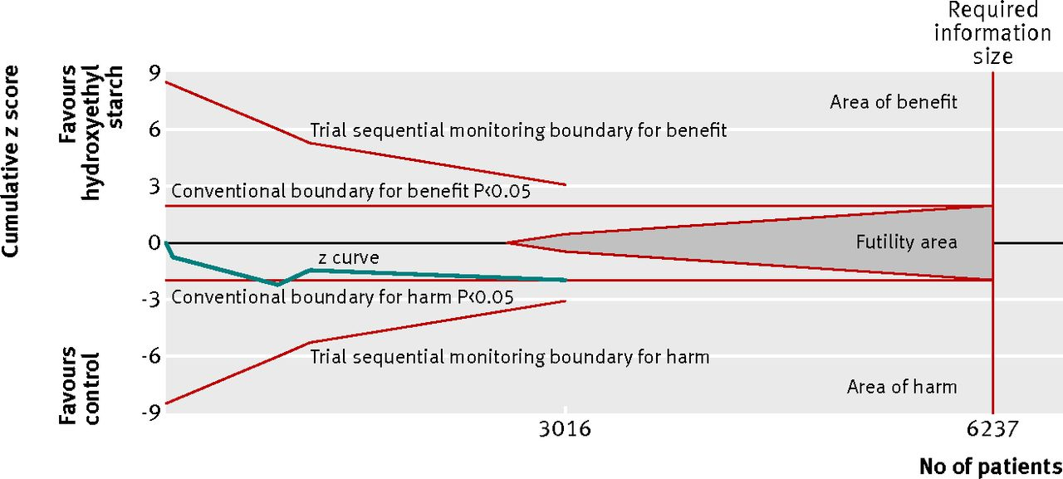
Trial Sequential Analysis (TSA)
TSA used to adjust meta-analysis for multiple looks at the data when a M-A is updated
  Similar to interim analysis in a single clinical trial
  Crudely, the effect will be to make p-values less “significant”

Slide 55
Using evidence synthesis to help inform the next study
Related to TSA is the issue of how a meta-analysis should inform the design of future studies
  Including comparators & sample size
Would you be comfortable with a £1 million trial going ahead that had 0 chance of changing the conclusion of an existing meta-analysis?
  When there is some heterogeneity this is very possible(!)
Should Cochrane reviews place more emphasis here and play an active role in Evidence Based Research?
  “Inform the future as well as summarise the past”

Slide 56
Narrative synthesis of qualitative data
Textually describing the overall effect noting variations in study characteristics, implementation, etc.
Synthesis involved bringing data together at some level – more than simply summarising one study at a time
Used when high level of heterogeneity contra-indicate meta-analysis
  Not just when statistical heterogeneity – other sources include study design, conceptual (intervention, outcome, context, population)
Identifies patterns and explanations for variation in effects
  E.g. what works for who, in what circumstances
Workshops on this over the last couple of days by Hilary Thomson and others.

Slide 57

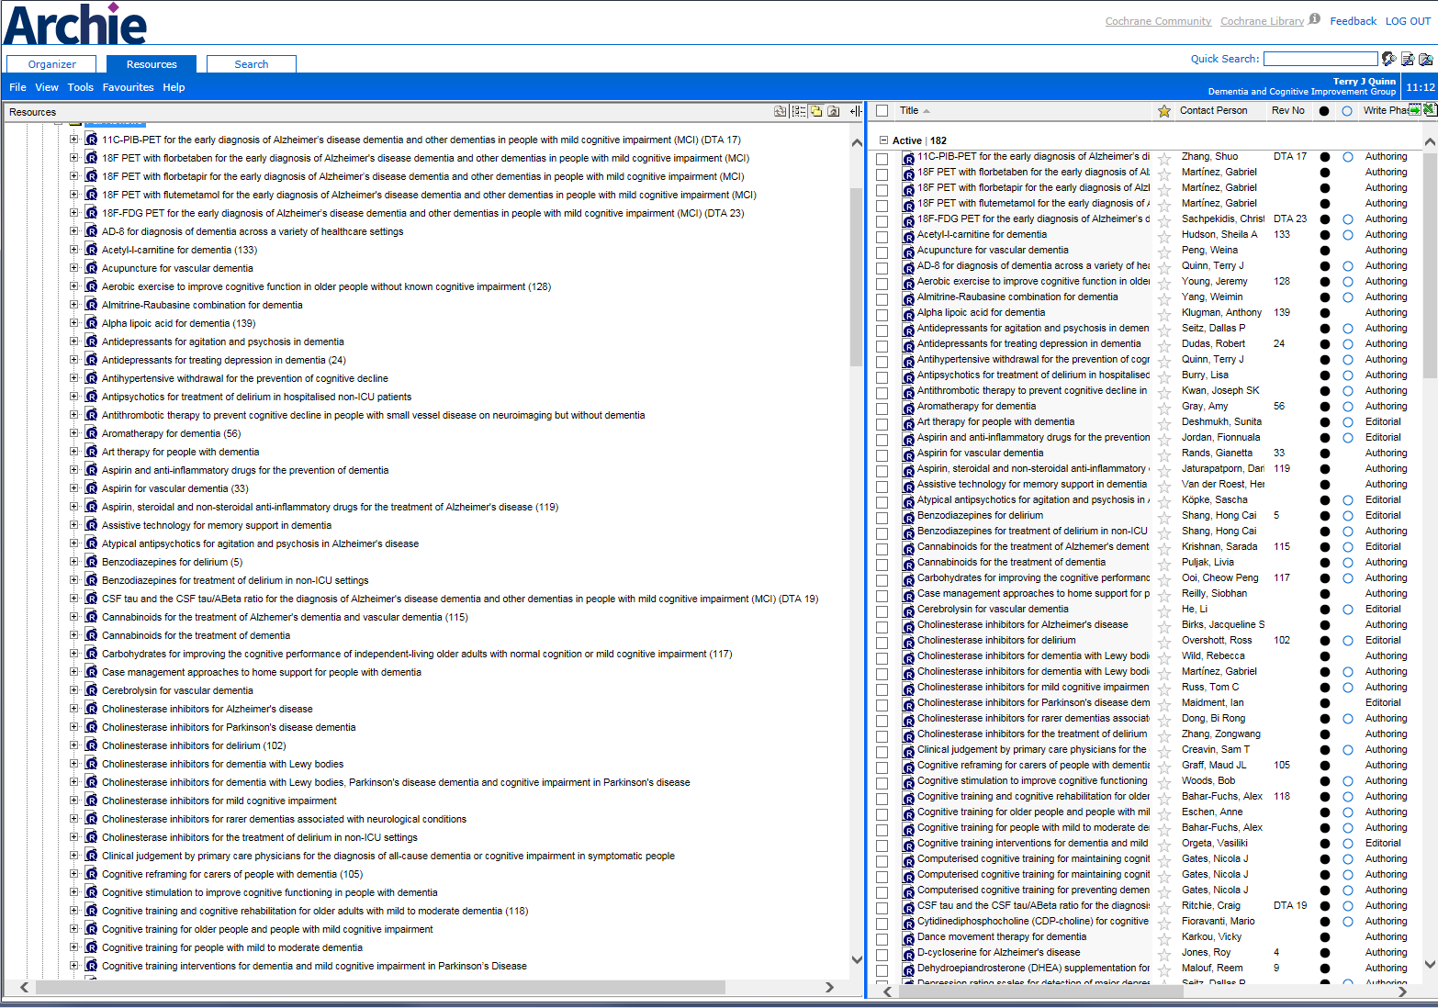
How can CRSU help your group

Slide 58
How can CRSU help your group
Studies needing updates
Donepezil for vascular dementia
Galantamine for vascular dementia
Rivastigmine for vascular dementia
Non-pharmacological (multi-component) interventions for managing delirium
IQCODE for detection of dementia
AD-8 for detection for dementia
Exercise interventions in dementia

Slide 59
How can CRSU help your group
Studies needing updates | Can CRSU help
Donepezil for vascular dementia | NMA of cholinesterase inhibitors in vascular dementia
Galantamine for vascular dementia
Rivastigmine for vascular dementia
Non-pharmacological (multi-component) interventions for managing delirium | Component NMA of non-pharm interventions
IQCODE for detection of dementia (x3) | Overview of informant tools for detection of dementia Comparative DTA
AD-8 for detection for dementia
Exercise interventions in dementia | Implications for research – what size should the next study be…………….

Slide 60
Website: www.nihrcrsu.org
Twitter: @NIHRCRSU
E-mail: moira.sim@glasgow.ac.uk

