Slide 1
MetaInsight: an interactive web-based tool for analyzing, interrogating and visualizing network meta-analyses
Biostatistics Research Group, Department of Health Sciences
Rhiannon K Owen
@RhiannonKOwen
Acknowledgements: Naomi Bradbury,
Nicola Cooper, Alex Sutton

Slide 2
Conflicts of interest
I have no actual or potential conflict of interest in relation to this presentation.
The Complex Reviews Support Unit is funded by the National Institute for Health Research (NIHR) (project number 14/178/29).
Department of Health Disclaimer:
The views and opinions expressed herein are those of the authors and do not necessarily reflect those of the NIHR, NHS or the Department of Health.

Slide 3
If you would like to follow the demo on your own device please scan the QR code or go to: https://crsu.shinyapps.io/metainsightc/
Biostatistics Research Group, Department of Health Sciences
MetaInsight demonstration

Slide 4
Background
Web applications are increasingly being used to analyse, explore, and visualize data
A powerful package called Shiny has recently been developed to interact with the statistical package R¹
https://shiny.rstudio.com/
Whilst R acts as a backbone for the tool, it is accessed “behind the scenes” on an internet cloud
User does not need to download any software other than a web-browser
Works on all mobile and internet browsers (so far…!)
Example of a Shiny web application

Slide 6
Motivation
Through supporting NIHR funded researchers (including Cochrane) as the NIHR Complex Reviews Support Unit (CRSU), we have identified software as a barrier to greater adoption of methods. There is currently a need:
for results to be presented in more intuitive and user-friendly formats to facilitate improved understanding
to sustainably increase capacity by empowering informed non-specialists to be able to conduct more clinically relevant reviews

Slide 7
Network meta-analysis
Network meta-analysis (NMA) is a powerful analysis method used to identify the best treatments for a condition and is used extensively by healthcare decision makers
Many software routines exist for conducting NMA including:
netmeta in R²
gemtc in R³
pcnetmeta in R⁴
network in Stata⁵
NICE Technology Support Documents (TSD) for WinBUGS⁶
Whilst software routines for performing NMA exist, they require considerable statistical programming expertise in WinBUGS and R, amongst others

Slide 8
How the tool was created
At the heart of MetaInsight is the frequentist NMA package developed in R, netmeta²
MetaInsight makes use of the many functions that netmeta offers e.g. network and forest plots, analysis, and assessment of inconsistency
Additional bespoke R code was also developed specifically for the tool

Slide 9
If you would like to follow the demo on your own device please scan the QR code or go to: https://crsu.shinyapps.io/metainsightc/
Biostatistics Research Group, Department of Health Sciences
MetaInsight demonstration

Slide 10
Data entry

Slide 11
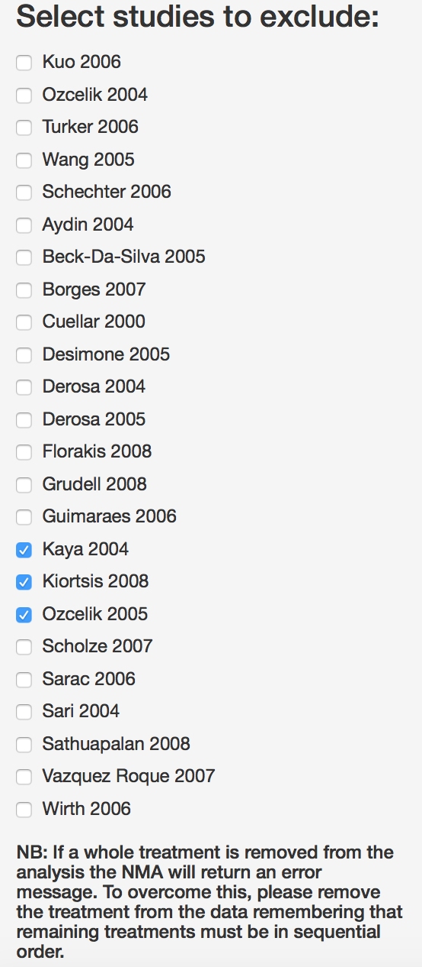
NMA and study options for sensitivity analyses

Slide 12
Study results

Slide 13
Network plots

Slide 14
Forest plots

Slide 15
Comparison plots

Slide 16
Inconsistency

Slide 17
What MetaInsight adds
A freely available tool that conducts NMA via the web, whilst leveraging established routines in R
An interactive environment that presents results in a visually appealing format
Performs sensitivity analysis in real time to aid decision makers ability to scrutinise the robustness of analysis findings
Increase capacity of complex and specialist analysis approaches
It is hoped that this tool will enable researchers to answer more clinically relevant questions (such as which treatment is the most effective overall?) and in the long term contribute to improved healthcare decision making as a result

Slide 18
Future work
Possible extensions:
Include study-level covariates
Incorporate 3D plots for NMA
Explore the possibility of using a Bayesian framework
Risk of bias
Create and re-publish the tool around a particular dataset that is ‘hard-wired’
E.g. allowing our tool to be supplied as a web-extra for journals publishing NMA articles
Allows the reader to explore the data and scrutinise assumptions of the analysis

Slide 19
References
[1] Chang WC, J.; Allaire, JJ.; Xie, Y.; McPherson, J. shiny: Web Application Framework for R. 2017.
[2] Gerta Rücker, Guido Schwarzer, Ulrike Krahn and Jochem König (2017). netmeta: Network Meta-Analysis using Frequentist Methods. R package version 0.9-6. https://CRAN.R-project.org/package=netmeta
[3] Gert van Valkenhoef and Joel Kuiper (2016). gemtc: Network Meta-Analysis Using Bayesian Methods. R package version 0.8-2. https://CRAN.R-project.org/package=gemtc
[4] Lifeng Lin, Jing Zhang, James S. Hodges, Haitao Chu (2017). Performing Arm-Based Network Meta-Analysis in R with the pcnetmeta Package. Journal of Statistical Software, 80(5), 1-25. doi:10.18637/jss.v080.i05
[5] White, I.R., 2015. Network meta-analysis. Stata journal. Stata Press, Texas.
[6] Dias S, Welton NJ, Sutton AJ, Ades A. NICE DSU Technical Support Document 1: Introduction to evidence synthesis for decision making. University of Sheffield, Decision Support Unit. 2011:1-24.

Slide 20
Thank you for listening. Any questions?
The Complex Reviews Support Unit (CRSU) is funded by
the National Institute for Health Research
(project number 14/178/29)
Department of Health Disclaimer: The views and opinions expressed herein are those of the authors and do not necessarily reflect those of NIHR, NHS or the Department of Health

